Slide 1
IE 362 Lecture 3: Linked List
Il-Chul Moon
Department of Industrial and Systems Engineering
KAIST

Slide 2
Problems of array

Slide 3
Weekly Objectives
This week, we learn our first data structure: linked list.
Objectives are
Firmly understanding how references work
Understanding various linked list structures
Singly linked list, doubly linked list, circular linked list…
Acquiring the implementation ability of linked lists
Should be able to code the linked lists in Matlab
Understanding the procedures of linked list management
Insert, delete, search…
Should be able to estimate the number of steps for inserts, deletes, and searches

Slide 4



Scenario for List
You are looking for Koh in the mass public
You are going to ask one by one “Are you Ms. Koh?”
Sometimes, you ask the question to a person multiple times
You realize that this is not going to work!
So, you line up the people and again ask the question one-by-one
You are looking for a restroom on the floor
The floor has a long corridor, and every room has an entrance to the corridor
You only need to follow the corridor
You have a dump of information of customers
How to store, search, and manipulate the information
You line them up as a list!

Slide 5
Why we study this?
We already covered the collection variable types
Vector and cell arrays: [ ], { }
You will use the list type for your software
Storing your customer information, your bank accounts, etc
By using the list collection variable,
You search, add, remove, and update the list
If your software is a serious one
You are concerned about whether the list type will work well or not
If you are concerned, you need to investigate the list type
Why don’t we build it from the scratch?
So, we understand how it is constructed and operates

Slide 6
Creating a List by Array
Cell array in our Matlab code
Each element is accessible by index
Index is typically a positive integer
Very simple creation
That’s why people use it
x(1)
x(2)
x(3)
x(4)
x(5)
‘a’
‘b’
‘d’
‘e’
‘f’

Slide 7
Search Procedure in Array
Let’s find ‘d’ and ‘c’ from the list in an array
Then, navigating from the first to the last until hit is the only way
x(1) == ‘c’ → False: No hit!
x(2) == ‘c’ → False: No hit!
x(3) == ‘c’ → False: No hit!
x(4) == ‘c’ → False: No hit!
x(5) == ‘c’ → False: No hit!
x(1)
x(2)
x(3)
x(4)
x(5)
After five retrievals,
we found that there will be no hit! (always N retrievals)
‘a’
‘b’
‘d’
‘e’
‘f’
After three retrievals,
we found the hit! (maximum N retrievals)
x(1) == ‘d’ → False: No hit!
x(2) == ‘d’ → False: No hit!
x(3) == ‘d’ → True: Hit!

Slide 8
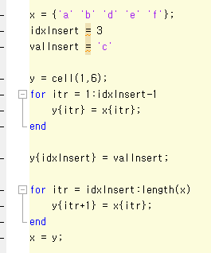
Insert Procedure in Array
Let’s insert ‘c’ between ‘b’ and ‘d’ in the list ( a = insert position index )
First, make new list, or y, with six cells
Second, copy the reference links of x[1:a-1] to y[1:a-1] (retrieval cnt.: a-1)
Third, put a reference link to ‘c’ in y[a] (retrieval cnt.: 1)
Fourth, copy the reference links of x[a:] to y[a+1:] (retrieval cnt.: n-a)
Fifth, change x’s reference to y’s reference
Total count of retrievals = a - 1 + 1 + n – a = n
x(1)
x(2)
x(3)
x(4)
x(5)
‘a’
‘b’
‘c’
‘d’
‘e’
‘f’
y(1)
y(2)
y(3)
y(4)
y(5)
y(6)

Slide 9
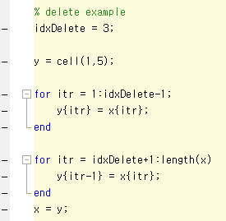
Delete Procedure in Array
Let’s remove ‘d’ in the list ( a = delete position index )
First, make new list, or y, with five cells
Second, copy the reference links of x[0:a-1] to y[0:a-1] (retrieval cnt.: a-1)
Third, copy the reference links of x[a+1:] to y[a:] (retrieval cnt.: n-a)
Fifth, change x’s reference to y’s reference
Total count of retrievals = a – 1 + n – a = n - 1
x(1)
x(2)
x(3)
x(4)
x(5)
x(6)
‘a’
‘b’
‘c’
‘d’
‘e’
‘f’
y(1)
y(2)
y(3)
y(4)
y(5)

Slide 10

Problems in Array
Whenever you put something in or get something out
You have to perform line-wise retrievals
Which is N retrievals (by assuming 100,000 – 1 ≒100,000)
This process is just like that
There is a line of airline passengers
You want to put a passenger in the middle of the line because his flight is about to leave
You are moving all the passengers one step back
Then, you put the customer in the line
What-if we have a magic to create a space in the middle of the line?
Array → you are bounded to the 1-dimension that you have
Linked list → you are bounded no more!

Slide 11
Basics of Linked List

Slide 12
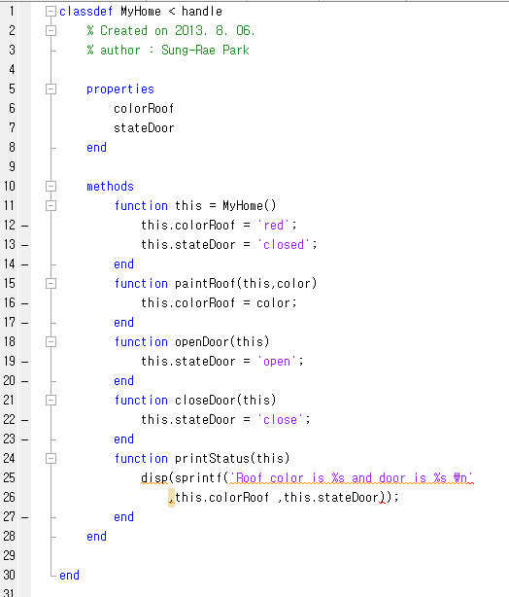
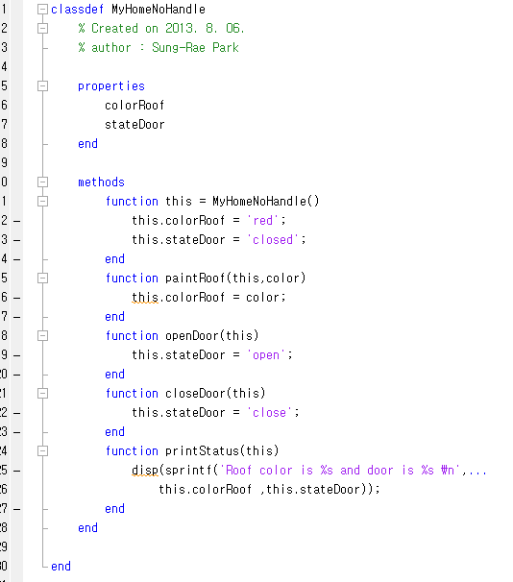
Detour: Class with Handle and without Handle
“< handle” means that it inherits the Object in Matlab world
What happens without “< handle”?
Matlab recognizes it as a value, not a reference…

Slide 13
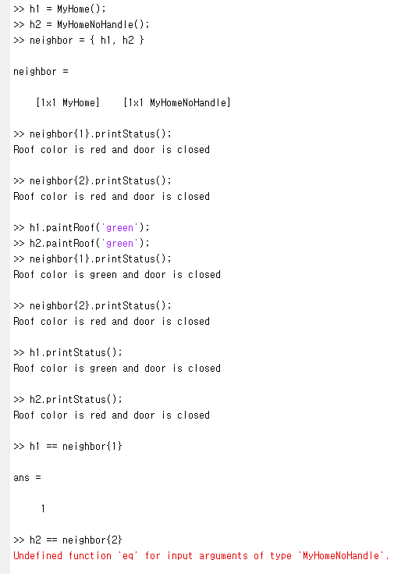
Detour: Short Experiment with Handles
Create two instances
h1 is from handle
h2 is not defined with handle
{ }
This is used to hold an array
Little different from a vector
You can hold diverse value types and classes with the array
When you call a “paintRoof”
h1 works
h2 does not work
Why?
Because
h1 is a reference
h2 is a value

Slide 14
Detour: Difference Between Handle and Value
h1
(MyHome)
h2
(MyHomeNoHandle)
Value copied
neighbor
(Cell Array)
neighbor{1}
neighbor{2}
(MyHome)
With “< handle”
Without “< handle”
Without “< handle”
Matlab always leaves the original value untouched
Matlab instead copies the original value to the new variable
With “< handle”
Matlab always stores and touches the single variable

Slide 15
Basic Structure: Singly linked list
Construct a singly linked list with nodes and references
A node consists of
A variable to hold a reference to its next node
A variable to hold a reference to its value object
Special nodes: Head and Tail
You can construct the singly linked list without them
But, using them makes search, insert and delete more convenient
Generally, requires more coding than array
Object
N e x t
Object
N e x t
Object
N e x t
Object
N e x t
Head
Tail
‘a’
‘b’

Slide 16
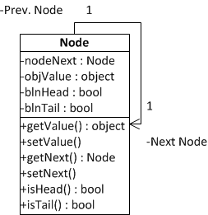
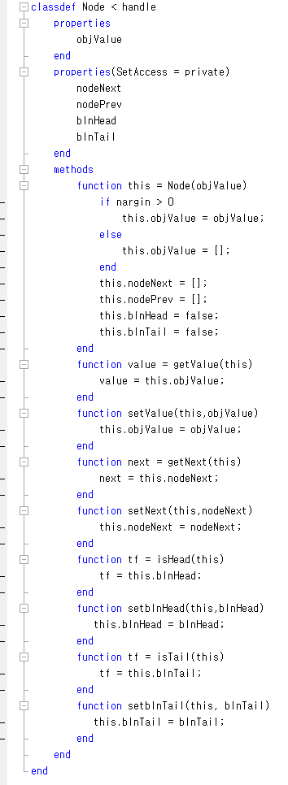
Implementation of Node class
Member variables
Variable to reference the next node
Variable to hold a value object
(Optional) Variable to check whether it is a head or not
(Optional) Variable to check whether it is a tail or not
Member functions
Various set/get methods

Slide 17
Head and Tail
Specialized node
Head : Always at the first of the list
Tail : Always at the last of the list
These are the two corner stone showing the start and the end of the list
These are optional nodes.
Linked list works okay without these
However, having these makes implementation very convenient
Any example?
Empty Linked List
Object
N e x t
Object
N e x t
Head
Tail
Linked List with Two Nodes
Object
N e x t
Object
N e x t
Object
N e x t
Object
N e x t
Head
Tail
‘a’
‘b’

Slide 18
Search procedure in singly linked list
Again, let’s find ‘d’ and ‘c’ from the list in an array
Just like the list by an array, navigating from the first to the last until hit is the only way
No difference in the search pattern, though you cannot use index any further!
Your list implementation may include the index function, but it is not required in the linked list
node.objValue == ‘c’ → False: No hit!
node.objValue == ‘c’ → False: No hit!
node.objValue == ‘c’ → False: No hit!
node.objValue == ‘c’ → False: No hit!
node.objValue == ‘c’ → False: No hit!
head
‘a’
‘b’
‘d’
‘e’
‘f’
tail
node.objValue == ‘a’ → False: No hit!
node.objValue == ‘b’ → False: No hit!
node.objValue == ‘d’ → True: Hit!
After five retrievals,
we found that there will be no hit! (always N retrievals)
After three retrievals,
we found the hit! (maximum N retrievals)

Slide 19
Insert procedure in singly linked list
This is the moment that you see the power of a linked list
Last time, you need N retrievals to insert a value in the array list
This time, you need only three operations
With an assumption that you have a reference to the node, Node_{prev} that you want to put your new node next
(1 Operation cnt.) First, you store a Node, or a Node_{next}, pointed by a reference from Node_{prev}’s nodeNext member variable
(1 Operation cnt.) Second, you change a reference from Node_{prev}’s nodeNext to Node_{new}
(1 Operation cnt.) Third, you change a reference from Node_{new}’s nodeNext to Node_{next}
(3) Add this reference
Node_{new}
‘c’
Over-written with a new reference to the new node
(2) Update this reference
head
‘a’
‘b’
‘d’
‘e’
‘f’
tail
(1) Store this node
Node_{prev}
Node_{next}

Slide 20
Delete procedure in singly linked list
This is the another moment that you see the power of a linked list
Last time, you need N retrievals to delete a value in the array list
This time, you need only three operations
With an assumption that you have a reference to the node, Node_{prev} that you want to remove the node next
(2 Operation cnt.) First, you retrieve Node_{next} that is two steps next from Node_{prev}
(1 Operation cnt.) Second, you change a reference from Node_{prev}’s nodeNext to Node_{next}
The node will be removed because there is no reference to Node_{remove}
(2) Update this reference
(1) Retrieve this node that is two step next
head
‘a’
‘b’
‘c’
‘d’
‘e’
‘f’
tail
Node_{prev}
Node_{remove}
Node_{next}
Over-written with a new reference to the next node of the removed one

Slide 21
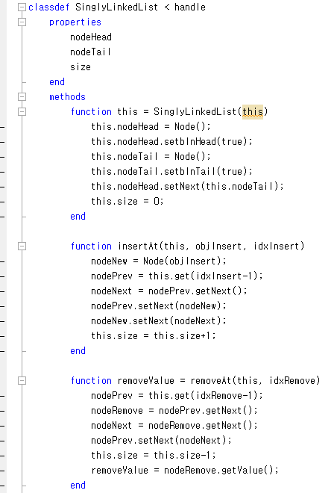
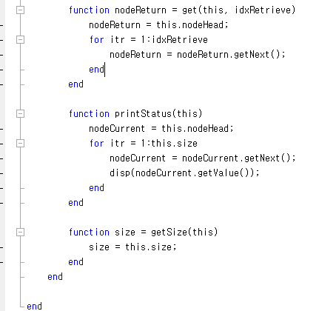
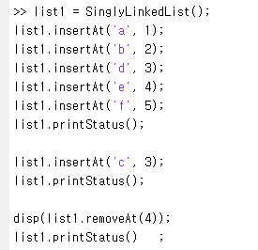
Implementation of Singly linked list
i retrievals to get i^{th} node
Empty Linked List
Object
N e x t
Object
N e x t
Head
Tail
4 Statements when you
have a Node_{prev}
3 Statements when you
have a Node_{prev}

Slide 22
Variants of linked list

Slide 23
Problems in Singly linked list
Problems?
Often, you can find a problem in the assumption
Consider this scenario
You are removing a unqualified customer from a credit card application list
Going through one-by-one
You find an unqualified customer at the 10th node
You want to remove the node
Then, you need the 9th node
You didn’t store the previous node, so you are retrieving 9th node again
Eventually, you are doing N retrievals to remove a node in the singly linked list
This is no better than the array list!
So, people add more information to the node to store a reference to the previous node as well as the next node
This list is called as a doubly linked list
Node referenced right now!
head
‘a’
‘b’
‘c’
‘d’
‘e’
‘f’
tail
Node_{prev}
Node_{remove}
Node_{next}

Slide 24
First variant: Doubly linked list
One-way search
Construct a doubly linked list with nodes and references
A node consists of
A variable to hold a reference to its next node
A variable to hold a reference to its previous node
A variable to hold a reference to its value object
Add one more reference to the node
This allows you to navigate both ways in the list
Singly Linked List
Head
N e x t
‘a’
N e x t
Tail
N e x t
‘b’
N e x t
Doubly Linked List
P r e v
head
N e x t
P r e v
‘a’
N e x t
P r e v
‘b’
N e x t
P r e v
tail
N e x t
Head
Tail
Two-way search

Slide 25
Insert procedure in doubly linked list
Similar to the insert procedure of the singly linked list
This time, you have to update two references for each node
With an assumption that you have Node_{prev}
(1 Operation cnt.) First, you store a Node, or a Node_{next}, pointed by a reference from Node_{prev}’s nodeNext member variable
(1 Operation cnt.) Second, you change a reference from Node_{prev}’s nodeNext to Node_{new}
(1 Operation cnt.) Third, you change a reference from Node_{new}’s nodePrev to Node_{prev}
(1 Operation cnt.) Fourth, you change a reference from Node_{new}’s nodeNext to Node_{next}
(1 Operation cnt.) Fifth, you change a reference from Node_{next}’s nodePrev to Node_{new}
Node_{new}
Should update the reference both ways
‘c’
head
‘a’
‘b’
‘d’
‘e’
‘f’
tail
Node_{prev}
Node_{next}

Slide 26
Delete procedure in doubly linked list
Again similar to the delete procedure of the singly linked list
Again, you have to update two references for each node
With an assumption that you have a reference to the node, Node_{prev} that you want to remove the node next
(2 Operation cnt.) First, you retrieve Node_{next} that is two steps next from Node_{prev}
(1 Operation cnt.) Second, you change a reference from Node_{prev}’s nodeNext to Node_{next}
(1 Operation cnt.) Third, you change a reference from Node_{next}’s nodePrev to Node_{prev}
The node will be removed because there is no reference to Node_{remove}
head
‘a’
‘b’
‘c’
‘d’
‘e’
‘f’
tail
Node_{prev}
Node_{remove}
Node_{next}

Slide 27
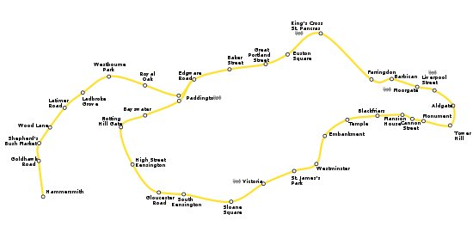
Second variant: Circular linked list
Some cases, you need a circular navigation method
For example,
A data structure for a sub-way line
A data structure for processing in a round-robin order
Card dealing
A base data structure for an implementation of a queue
A handy access to implement First-In First-Out → FIFO
We will learn why in the next week
head
‘a’
‘b’
‘c’
‘d’
‘e’
‘f’

Slide 28
Summary Table
 | Array List | Singly Linked List | Doubly Linked List | Circular Linked List
i^{th} Index Access | 1 operation | i operations | i operations | i operations
Search | N operations | N operations | N operations | N operations
Insert | N operations | c operations | c operations | c operations
Delete | N operations | c operations | c operations | c operations
Rewinding | O | X | O | O
Circular navigation | O | X | X | O
Why are we observing the number of operations?
Do you remember the criteria of good software design?

Slide 29

Detour: Good Software Design
Good or Bad Design?
 | Building Design | Software Design
Correctness | Meet the owner’s purpose Successful construction without faults | Meet the client’s purposes Successful implementation without errors
Robustness | Maintain integrity in a certain level of typhoons | Execute under expected overloads
Flexibility | Enable the future expansions and modifications of the structure | Enable the future updates and expansions of functions
Usability and Reusability | Good support for designed purposes Easy to use for 1) other purposes and 2) other areas | Good support for the designed Easy to use for 1) other purposes and 2) other contexts
Efficiency | Easy to build Cover less area Good mobility in the structure | Easy to implement Smaller size Faster execution

Slide 30
Further Readings
Introduction to Algorithms by Cormen et al.
pp. 200-213

